Slide 1
Living in the Post-Exile World
Ezra: Return to the law
Ruth: Live peacefully
Esther: Clever success in foreign land
Daniel: a new Joseph

Slide 2
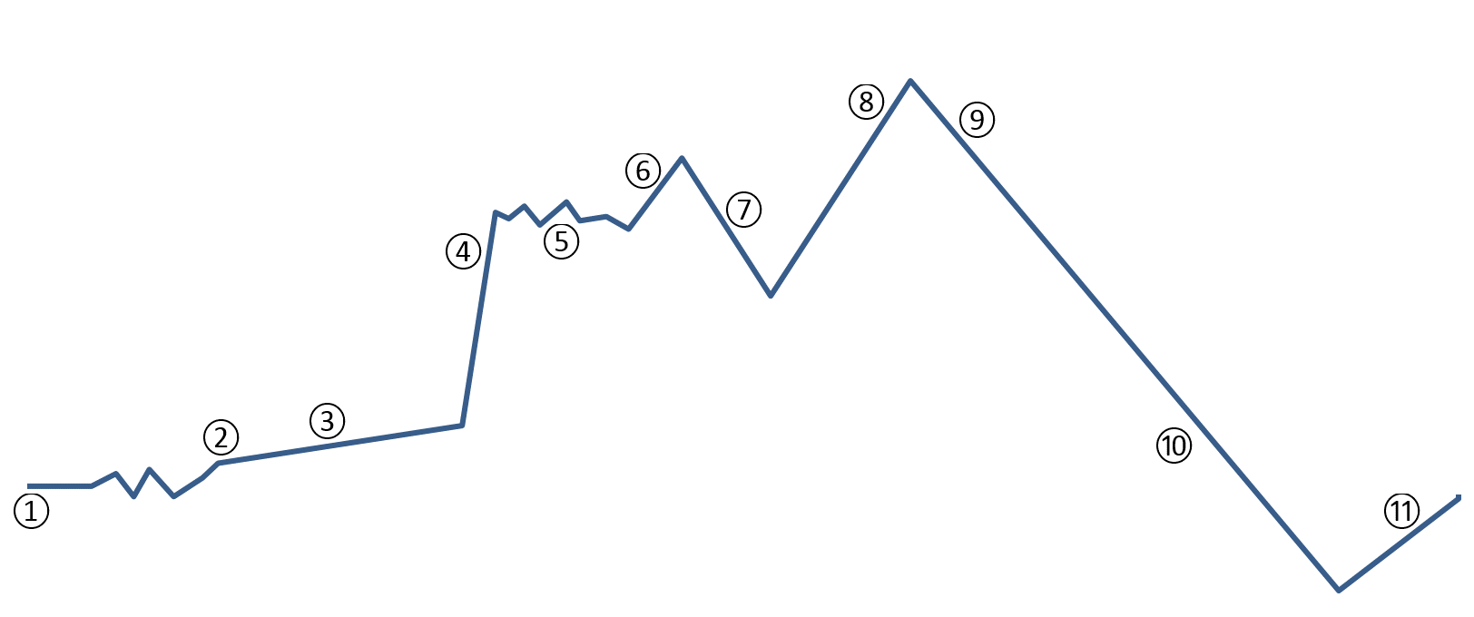
Hebrew Bible Overview
Abraham, Jacob, Moses, Joshua, David, Solomon, Cyrus
Egypt, Desert, Judges, Conquest
(Kingdom, Divided Kingdom, Exile, Post Exile)

Slide 3
The Three-part Hebrew Bible
The Law, Books of Moses, Pentateuch (Torah)
Genesis, Exodus, Leviticus, Numbers, Deuteronomy
The prophets (Nevi’im)
The former prophets: Joshua, Judges, 1&2 Samuel, 1&2 Kings
The latter prophets: Isaiah, Jeremiah, Ezekiel; The scroll of the twelve: Amos, Hosea, Micah, Joel, Obadiah, Jonah, Nahum, Habakkuk, Zephaniah, Haggai, Zechariah, Malachi
The Writings (Kethuvim) (written after exile)
Psalms, Job, Proverbs
The Festive Scrolls (Megillot): Ruth, Song of Songs (Song of Solomon), Ecclesiastes, Lamentations, Esther
Daniel, Ezra-Nehemiah, 1-2 Chronicles

Slide 4
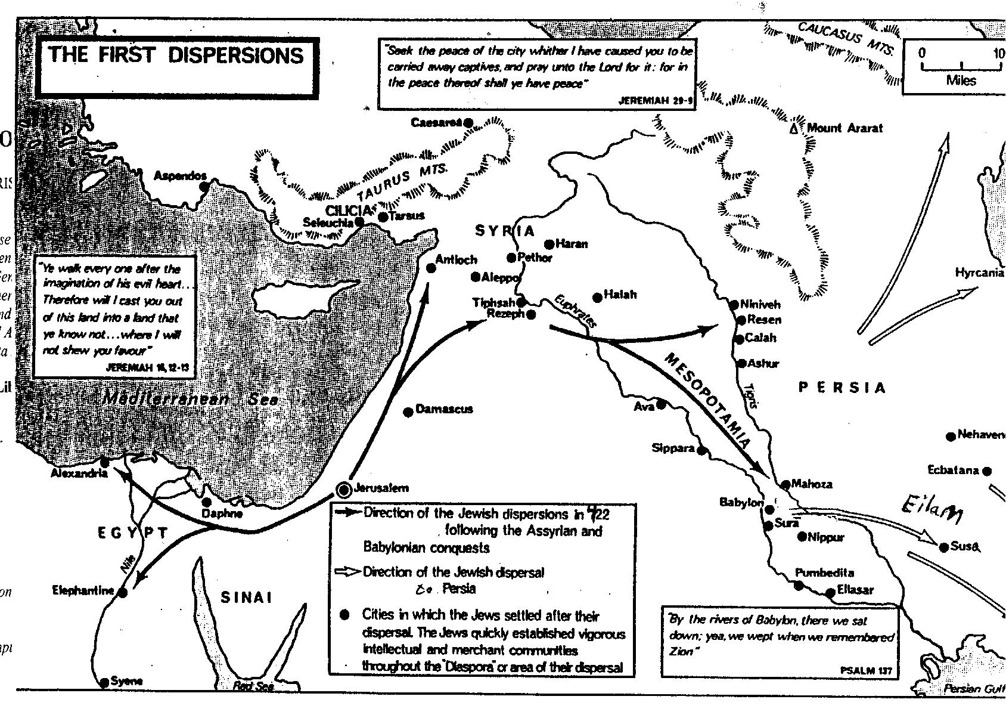
Diaspora.
Jews living away from their homeland, among foreigners have new needs and new interests. How do The Writings help to address these?

Slide 5
Ezra
Ezra-Nehemiah is a two-part book
Ezra is a priest,
rebuilds Jerusalem temple
Nehemiah is a government official,
rebuilds the wall around Jerusalem

Slide 6
The Book of Ezra
Ezra, the name means "God-helps"
Theme
Ezra and Nehemiah tell about the return of the Jews from exile, and discuss re-establishing society, from religion to security.
Author
Generally believed to be Ezra.

Slide 7
Characters
Ezra
The priest
Led some exiles to Jerusalem and solved the problem of mixed marriages
King Cyrus
King of Persia
Helped with the rebuilding of the temple
King Artaxerxes
King of Persia after Cyrus
Temporarily stopped the building the temple

Slide 8
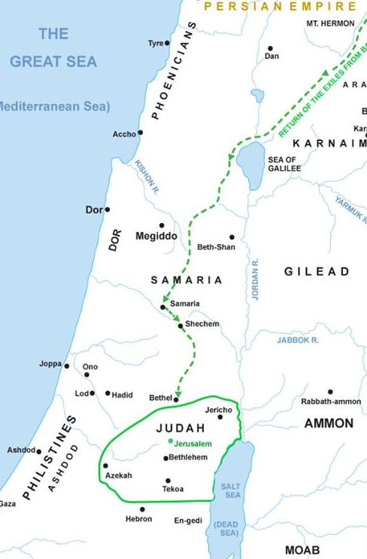
Zerubbabel
Governor, led first wave or returning Jews; laid the foundation for the Temple
Jeshua
First high priest, before Ezra
With Zerubbabel, led Jewish returnees from exile and began to rebuild the Temple
Haggai and Zechariah
prophets
supported Zerubbabel and Jeshua

Slide 9
Summary of Events by Chapter
Chap. 1-6 — Rebuilding of the temple
Ch 1 Decree of Cyrus that the Jews could return (536 BC)
Ch 2 Names of those who return
Ch 3 Laying the foundation of the temple
Ch 4 Local people oppose the work and move the king to stop it
Ch 5 Prophets encourage work to resume; ask King Darius
Ch 6 Decree of Darius: work resumes; temple completed
Chap. 7-10 — Return of Ezra and purifying the people from foreign wives
Ch 7 Ezra decreed to lead another group to return (458 BC)
Ch 8 Preparation and journey
Ch 9,10 The people put away wives and children of foreign blood

Slide 10
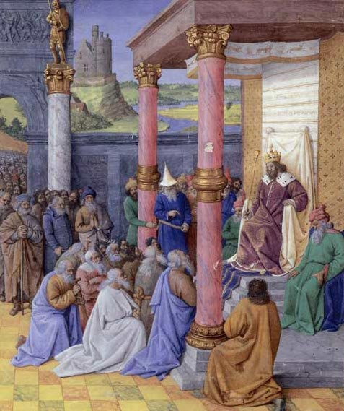
God touched the heart of King Cyrus of Persia to allow the exiles to return
King Cyrus of Persia gave permission for the exiles to return

Slide 11
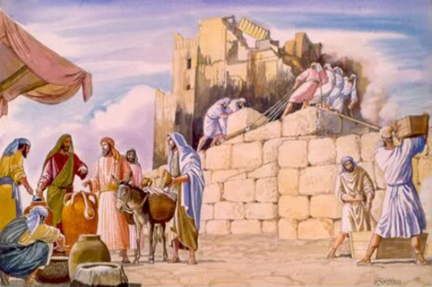
Zerubbabel and Jeshua set to rebuild the temple of God
The governor and their associates wrote letter to King to continue rebuilding the temple.

Slide 12
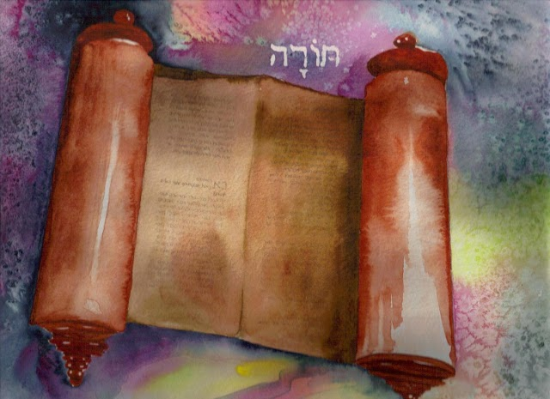
King Artaxerxes gave permission to people wanted to go to Jerusalem with Ezra.
King gave Ezra instructions on what to do with the offerings

Slide 13
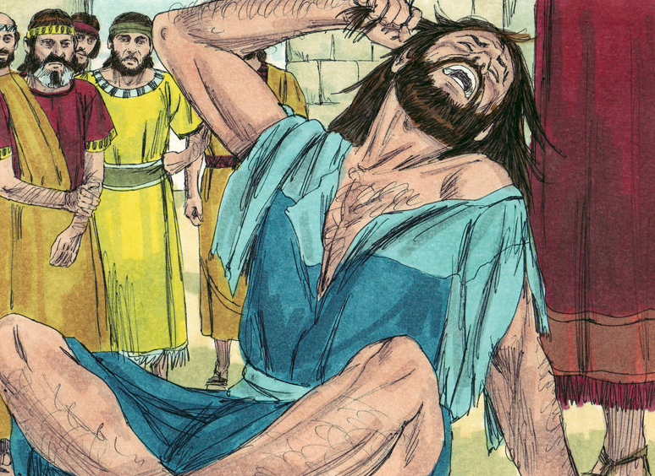
Ezra is dismayed at how the Israelites defile themselves through intermarriage with other nations
Ezra urged people to confess their sins and separate from their foreign wives.
Notes:
After three months, people sent their foreign wives away and burnt the offering to God to confess their sin.

Slide 14
Reminder
Return to Jerusalem
Spread of generation & living in unity
Rebuild the temple and restart the ceremonies
Turn back to God
Intermarriage forbidden

Slide 15
Megillot (Festive Scrolls)
Placed together in the “Masoretic Text” (MT) of the Hebrew Bible (around 700 CE) (The authoritative Hebrew Bible)
Five short books were chosen to be read publicly at the five main Hebrew festivals.
Esther and Lamentations are most commonly still read today.
They vary in style, tone, and content.
Together they present a multifaceted view of human nature.
No legalistic absolutes (like the Torah)
No certainties about God’s will (like the prophets)
God not mentioned much (except in Lamentations)
Different perspectives on handling life’s problems
Each affirms that life is good.

Slide 16
Megillot (Festive Scrolls)
Book | Ecclesiastes | Esther | Song of Solomon | Ruth | Lamentations
Hebrew name of Holiday | Sukkot | Purim | Pesach | Shavuot | Tisha B’Av
Description of holiday | Feast of Tabernacles or Booths (remember time in tents in wilderness) | Purim or Festival of Lots (deliverance from Persian attack) | Passover (end of slavery in Egypt) | Pentecost (harvest festival) | Fast of the Ninth of Av (mourning the destruction of Temple by Babylonians (587 BCE) and Romans (70 CE)
Time period | Autumn | Early spring | Spring | Late Spring, Early summer | Summer
Date this year | 19 Sept. 2013 中秋節 (this year) | 16-17 March 2014 | 15 April 2014 | 4 June 2014 | 4 August 2014

Slide 17
What do Esther & Daniel have in common?
Written during the post exile.
Hebrews triumph in foreign courts.
Reminiscent of Joseph in Pharaoh's court.
Encourages Hebrews to remain faithful in difficult times.
Expresses desire of Hebrews prevailing over Gentiles (non-Jews).

Slide 18
Ruth
The Greatest story of filial piety.
Ruth loves, and supports her mother-in-law, choosing to be a Jew, rather than return to her own family and people group.

Slide 19
Character
Tribe of Judah
Naomi
Elimelech
Orpah
Chilion
Mahlon
Ruth
Boaz
Obed
Jesse
David

Slide 20
Story line :
Ruth1

Slide 21
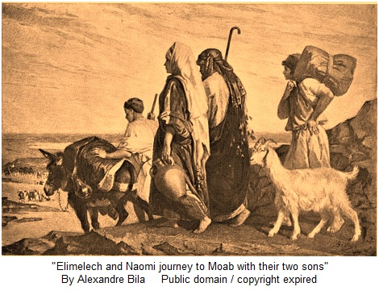
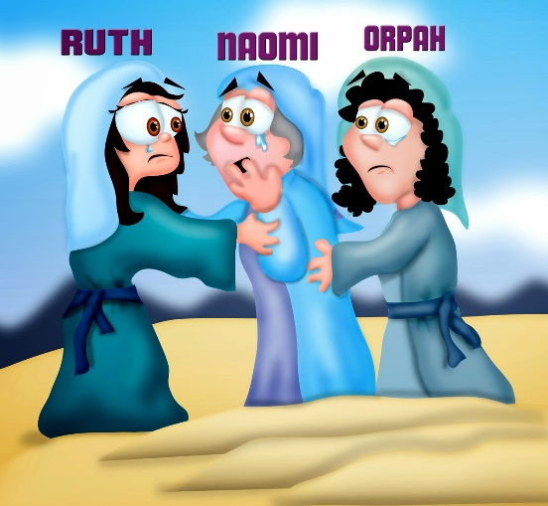
Elimelech’s family goes to Moab
Famine in Judah
Naomi’s male relatives die

Slide 22
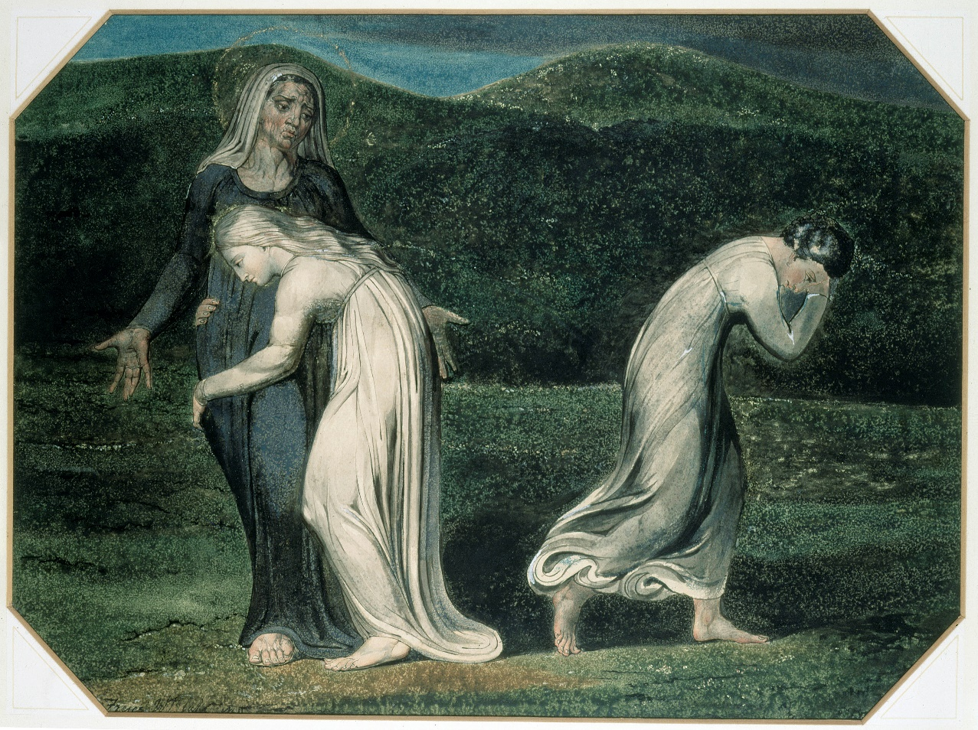
Naomi and her Moabite daughters-in- law
Return back to Judah
Naomi persuades Oraph and Ruth to go back to their families
Ruth chooses to stay with Naomi & return to Bethlehem

Slide 23
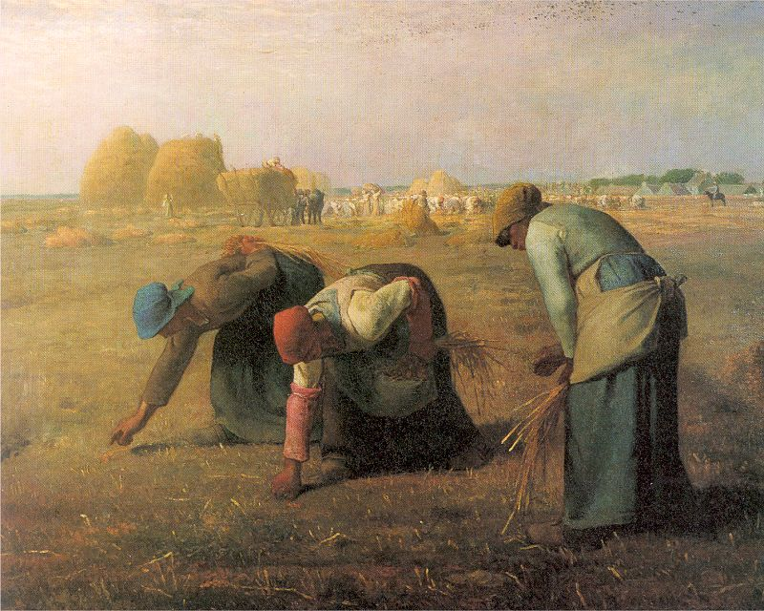
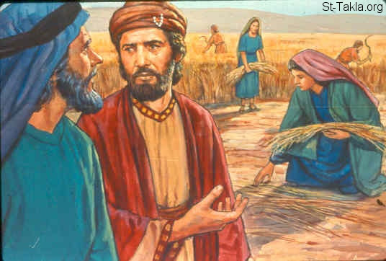
Part 2: Ruth meets Boaz
Ruth and Boaz met in the harvest fields

Slide 24
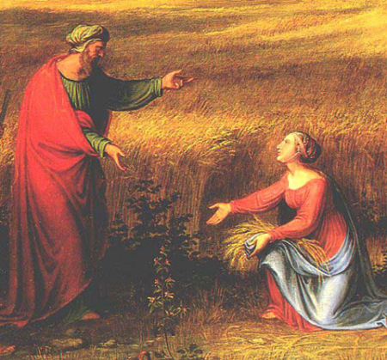
Boaz shows kindness to Ruth & Ruth tells Naomi

Slide 25
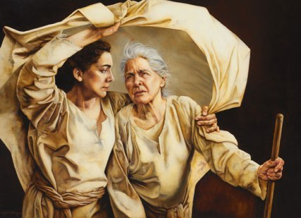
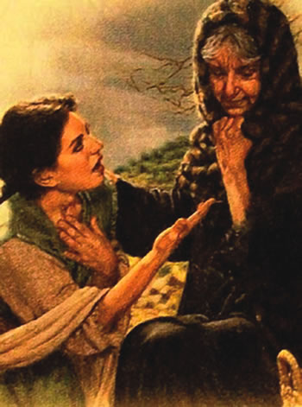
My daughter, am I not to get you a resting-place where you may be in comfort?

Slide 26
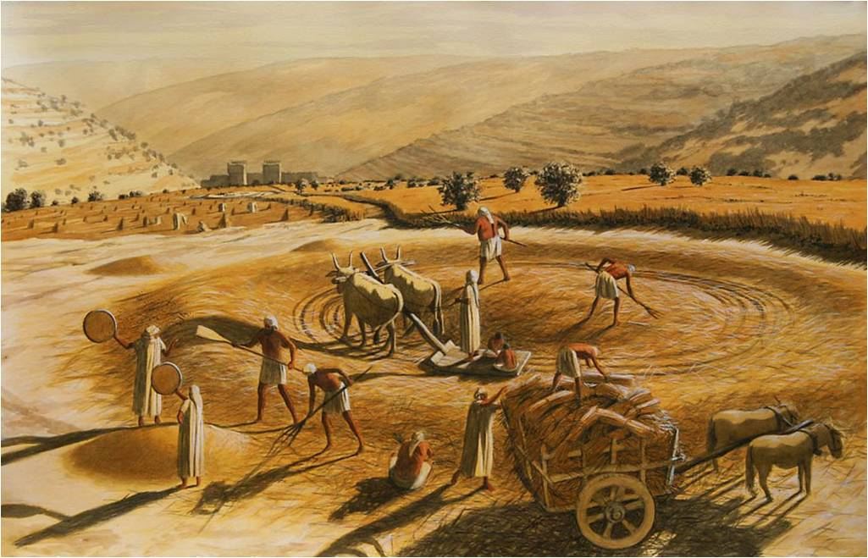
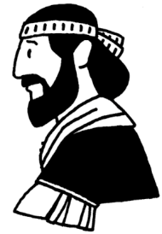
Naomi’ s Plan
Tonight Boaz is separating the grain from the waste in his grain-floor.

Slide 27
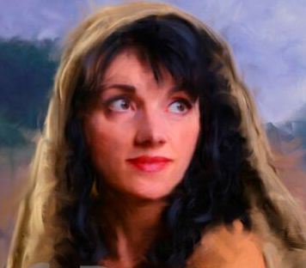
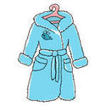
Take a bath.
Rub your body with sweet oil.
Put on your best robe.
Go down to the grain-floor; but do not let Boaz see you.

Slide 28
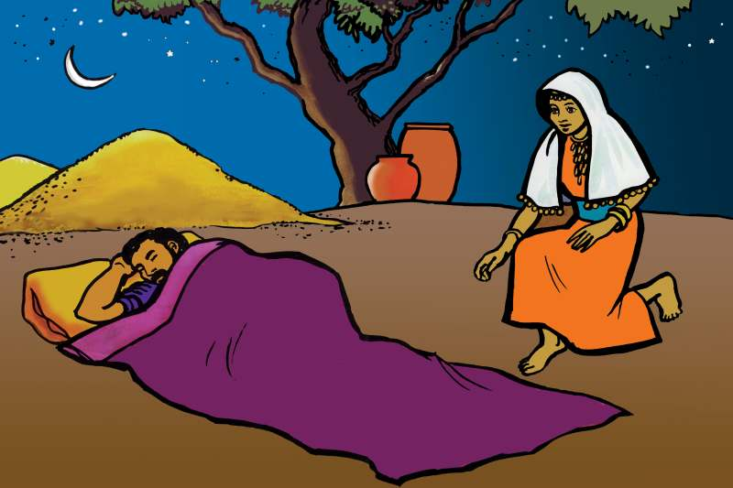
Take note of the place where he is sleeping, and go in there.
Uncover his feet, and lay down.
He will tell what you should do.

Slide 29
I will do all you say.

Slide 30
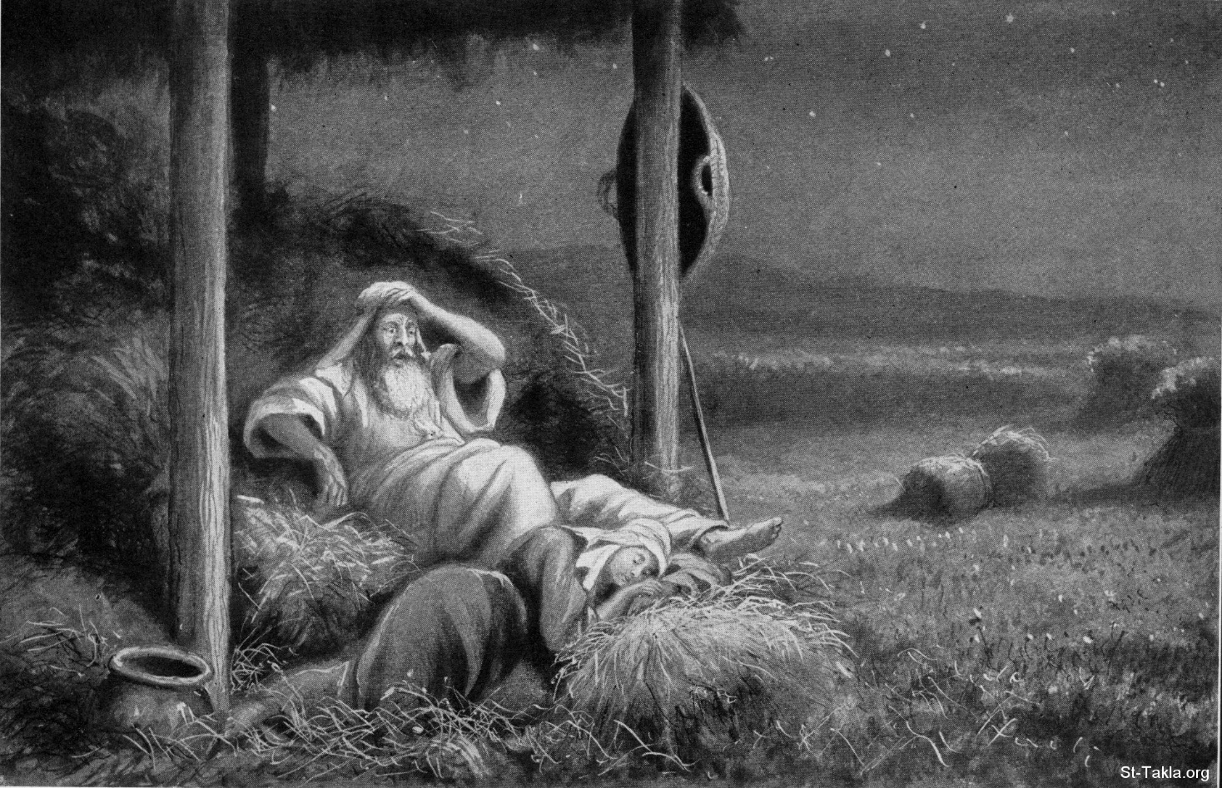
Boaz slept at the end of the mass of grain after he finish his meal.
In the middle of the night, Boaz turned himself, and found a woman sleeping at his feet.

Slide 31
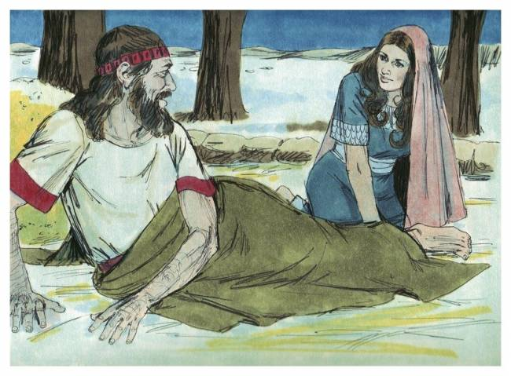
Whoa! Who are you?
I am your servant Ruth; take me as wife, for you are a near relation.

Slide 32
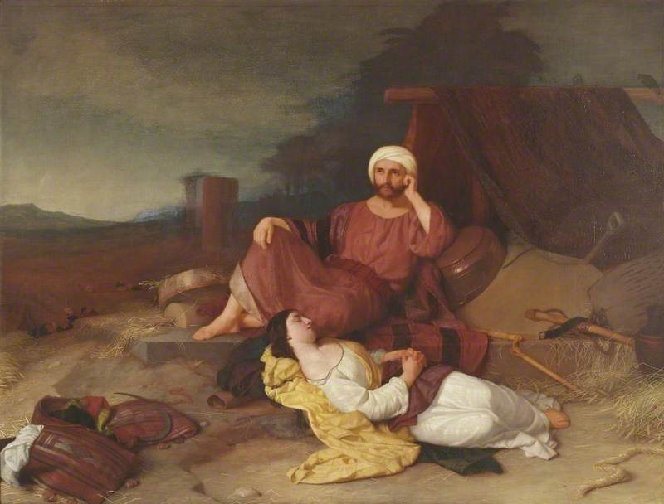
Boaz is impressed by Ruth’s virtue, but there is a closer relative.
He promises to marry her if the nearer relation doesn’t.
Ruth sleeps at his feet till the morning.
Boaz: Let it not be known that a woman came into the floor.

Slide 33
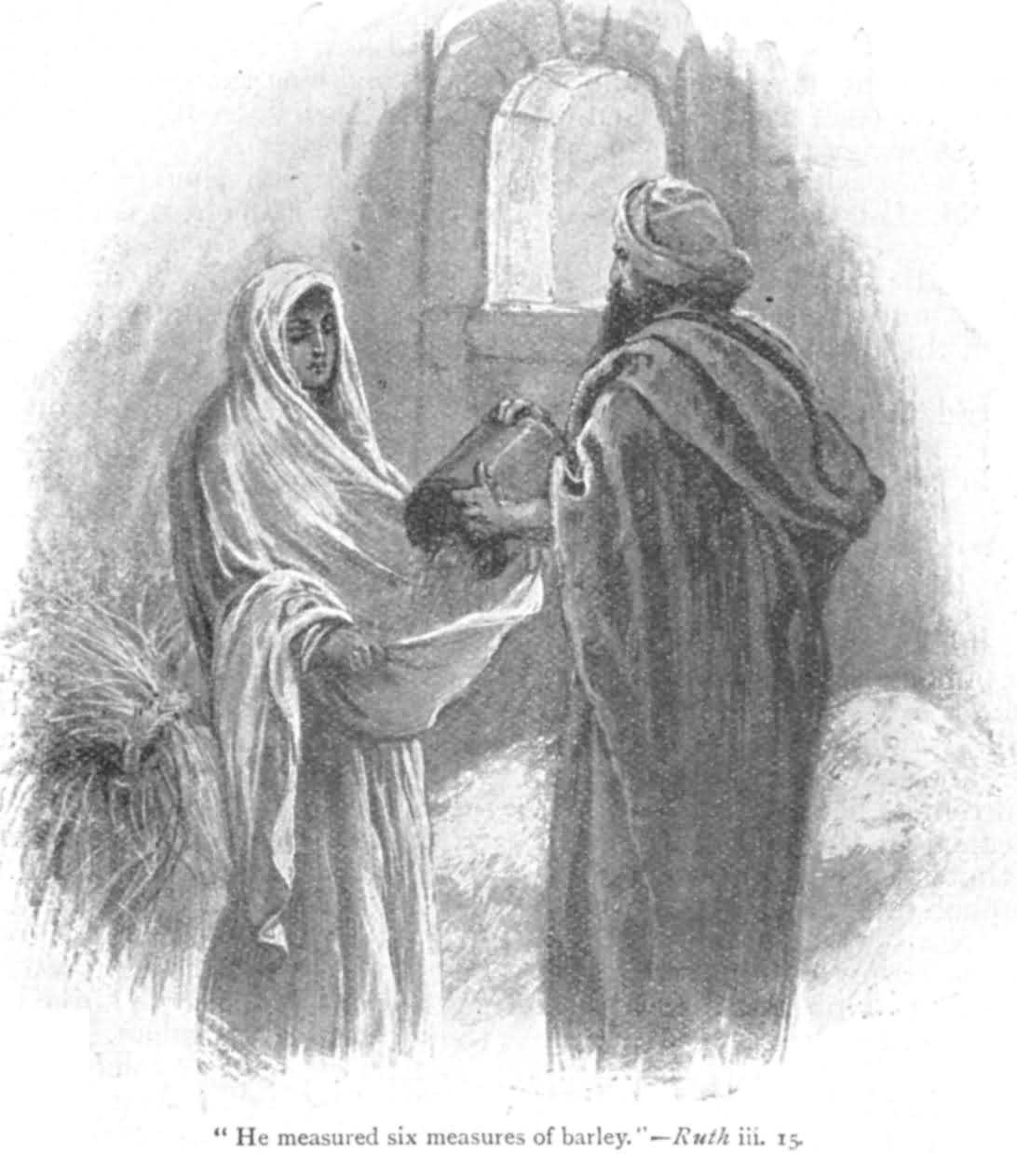
Boaz gave Ruth six measures of grain in her robe.

Slide 34
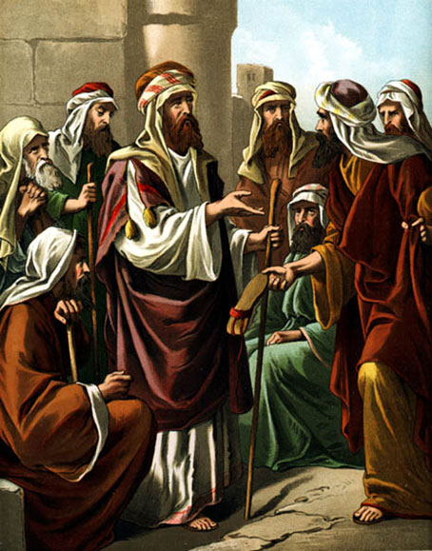
The Marriage of Boaz and Ruth
Boaz suggests the next-of-kin to redeem Naomi’s parcel of Elimelech’s land in the presence of the ten men of the city.
The next-of-kin refused for it would damage his own inheritance.
They exchange sandals to give the right of redemption to Boaz.
The marriage of Boaz and Ruth

Slide 35
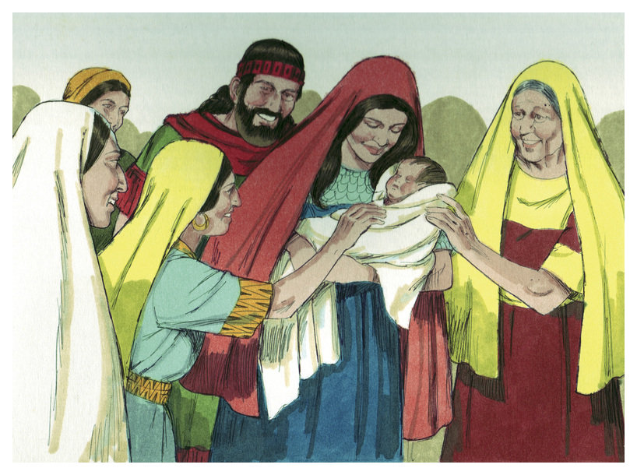
The Genealogy of David
Boaz took Ruth and she became his wife
Ruth bore Boaz a son, Obed, who became the father of Jess, the father of David.
The descendants of Perez: Perez→Hezron→Ram→Amminadab→
Nahshon→ Salmon→ Boaz→ Obed→ Jesse→ David

Slide 36
Themes and Meanings & Questions
Chesed
Emptiness and fullness
Laws of "redeemer“
Intermarriage
God’s Wisdom
Calm, pastoral, family story
One way to relate to the outside world

Slide 37
Esther
A Jewish queen in a foreign country saves her people

Slide 38
Esther
Why does the narrator never mention God?
Is Esther Mordecai’s puppet?
Does it imply that for Israel to survive in a hostile world, they need to use their wits rather than rely on God?
Can we assume God is active in the background to make the story work out?

Slide 39
Setting
Set during the time of Xerxes 1 (Ahasuerus) son of Darius (486-465 BCE)
Compare to Ruth. Not sensitive characterization, but an exciting melodrama (a sensational plot).
Mordecai is both a devout Jew and a loyal subject to the Persian king.
Esther has no trouble being completely assimilated. She hides her ethnicity/religion with no problem. (Daniel refuses)
Hebrews are an unassimilated group in Persian empire (Haman’s plot to destroy them reveals this).
Purim (cast lots): Haman casts lots to determine the day to exterminate the Jews. (Esther 3:7)

Slide 40
The Triumph
Since the King can not take back his edict, he makes a second edict encouraging Jews to arm & defend themselves (8:11). They achieve victory over all who would murder them on the very day that Haman had chosen for their extermination.
They “destroy, kill, and annihilate” those who would do so to them. Wow, redundancy for emphasis! (3:13, 7:4 & 8:11)

Slide 41
Patriotic Fiction?
There is no record of a queen Vashti or a Jewish queen.
Persian empire was never divided into 127 provinces (8:9).
No record of a decree either ordering the extermination of Jews or allowing Jews to attack Persian subjects
Mordicai, if he was deported to Persia from Babylon, would be at least 100 years old and Esther would not have been much younger.
Esther seems to be a variation of Ishtar, the Babylonian goddess of Love and fertility.
Mordecai seems derived from Marduk, the leading Babylonian deity.
The book is a clear cut depiction of Good verses evil in a classic mythic style.
More important than historical accuracy is what the story represents.
A story of Jews turning the table on those who would destroy them.
It is a profound statement about the heroic resistance necessary, in the face of overwhelming anti-Semitism, to ensure Jewish survival at any place and at any time in the modern world.

Slide 42
Daniel
Two distinct parts
Chptrs1-6: collection of stories about Daniel & Friends
Chptrs 7-12: describes four visions

Slide 43
Daniel
Written in 200 BCE about an earlier time (600 BCE).
Written for encouragement during a time of persecution.
Like Joseph in Pharaoh's court
Transported to a foreign court and becomes second in command while remaining faithful to Yahweh. (No compromise or hiding, unlike Esther)
Rises in power because of his ability to interpret dreams.
Ch 1. He and friends remain very faithful to Torah rules, even their diet. (Vegetarians?)

Slide 44
Daniel 2
Nebuchadnezzar’s first dream
Head = gold (Babylon under Nebuchadnezzar),
Chest & arms = silver (Media);
Body & thighs = bronze (Persia),
Legs = iron (Greece),
Feet = iron & Clay (Egypt & Syria)
Meteorite is God’s kingdom that will never be destroyed.

Slide 45
Daniel 3
The Fiery Furnace
Shadrach, Meshach, and Abednego in the fiery furnace.
Jews heroically refuse to bow before the golden image. (remember Aaron’s golden calf)
“If our God whom we serve is able to deliver us from the furnace of blazing fire and out of your hand, O king, let him deliver us. But if not, be it known to you, O king, that we will not serve your gods and we will not worship the golden statue that you have set up” (3:16-18). What amazing integrity!

Slide 46
Daniel 4
Nebuchadnezzar's second dream
A tree that is cut down. Nebuchadnezzar gets the heart of a beast.
Daniel’s God humbles those who walk with pride (4:34).
(Unfortunately, there is no record of any Babylonian King suffering a seven year fit of insanity, or converting to any form of monotheism).
Still, this presents the hope that an oppressive monarch could be taught humility before Yahweh.

Slide 47
Daniel 5
Belshazzar’s Feast
The writing on the wall. Daniels’ interpretations create puns out of the Hebrew words.
Mene, Mene: God has numbered the days of your kingdom and brought it to an end.
Tekel: you have been weighted on the scales and found wanting
Peres: Your kingdom is divided and given to the Medes and Persians.”

Slide 48
Daniel 6
Daniel in the Lion’s Den
Follows the same pattern as in Daniel 3.
Also follows plot of Esther.
Punishment meant for Daniel happens to those who schemed against him. Plotters and family members fed to lions. Poetic justice.
This Darius goes farthest in promoting the Hebrew god. He orders everyone in his empire to learn to fear the Jewish Deity (6:26-28).

